Slide 1





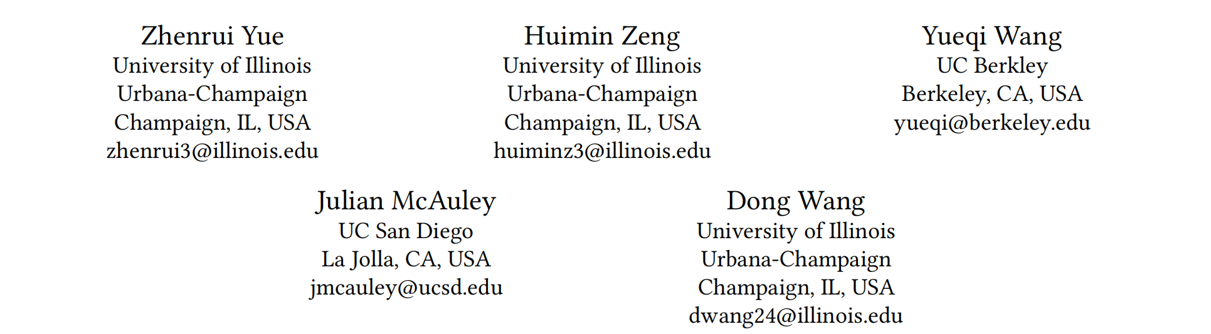





ATAI
Advanced Techniqueof Artificial Intelligence
ATAI
ChongqingUniversity _{AdvancedTechniqueof}
of Technology Artificial Intelligence
Chongqing University of
Technology
Chongqing University ^{ATAI}
_{of Technology} Advanced Techniqueof
Artificial Intelligence
Chongqing University of Technology
Chongqing University of Technology
Preference-Optimized Retrieval and Ranking for Efficient Multimodal Recommendation
Code: https://github.com/Yueeeeeeee/PRIME
2025.11.30
—— KDD_2025
Reported by Yang Hu
1

Slide 2

ATAI
AdvancedTechniqueof
Artificial Intelligence
ATAI
ChongqingUniversity _{AdvancedTechniqueof}
of Technology Artificial Intelligence
ChongqingUniversity of Technology
Motivation
1.The majority of existing methods explore static item attributes without considering additional contextual information (e.g., price, brand)
2.Overlooking the interaction between the retrieval and ranking stages may lead to suboptimal solutions for fine-grained recommendations
3.Existing approaches are computationally expensive for an increased number of candidate items and often require further post-processing to obtain the item ranks.

Slide 3

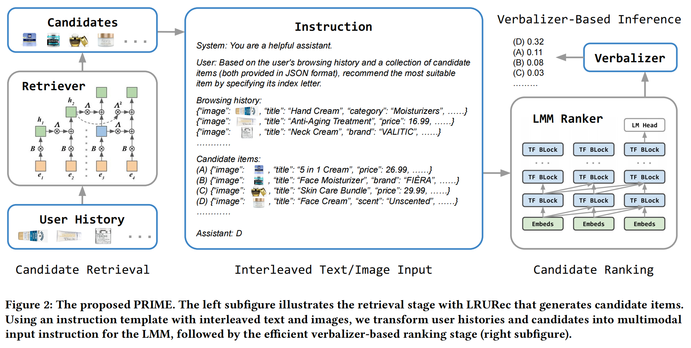
ChongqingUniversity of Technology
ATAI
AdvancedTechniqueof
Artificial Intelligence
ATAI
ChongqingUniversity _{AdvancedTechniqueof}
of Technology Artificial Intelligence
Overview

Slide 4
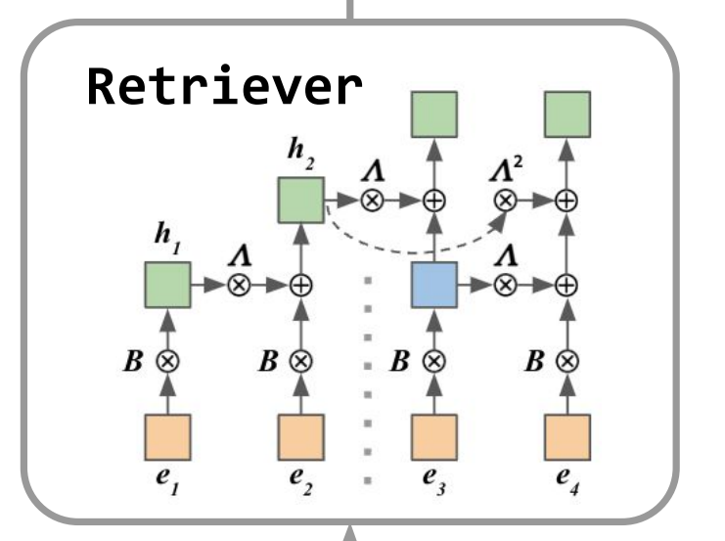
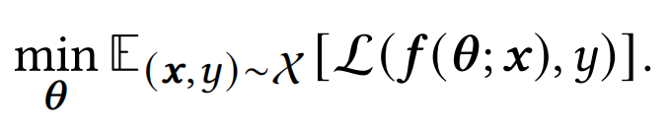
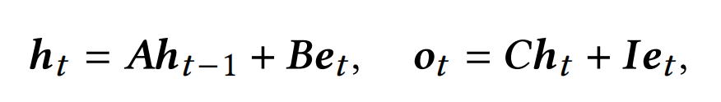
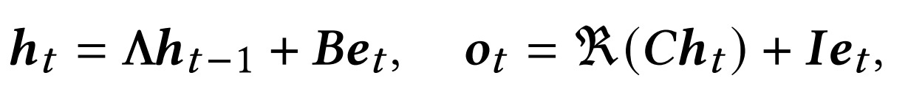
ChongqingUniversity of Technology
ATAI
AdvancedTechniqueof
Artificial Intelligence
ATAI
ChongqingUniversity _{AdvancedTechniqueof}
of Technology Artificial Intelligence
Method
(1)
(2)
(3)

Slide 5
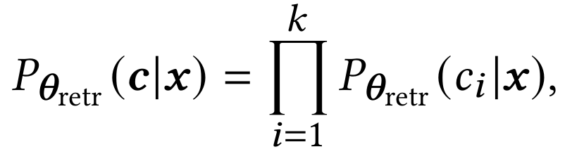
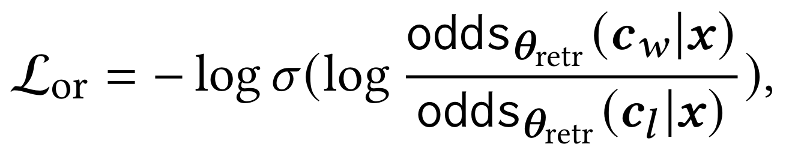
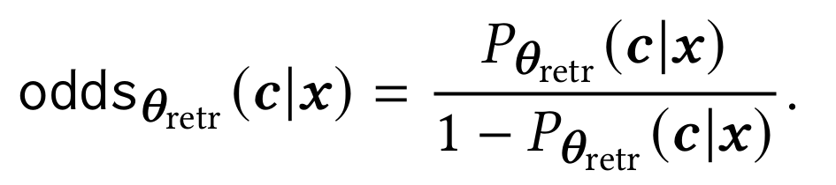
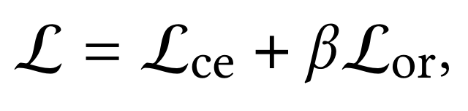
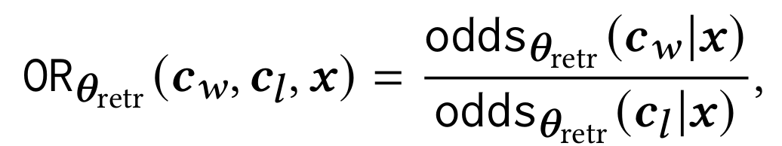
ChongqingUniversity of Technology
ATAI
AdvancedTechniqueof
Artificial Intelligence
ATAI
ChongqingUniversity _{AdvancedTechniqueof}
of Technology Artificial Intelligence
Method
(4)
(7)
(5)
(8)
(6)

Slide 6

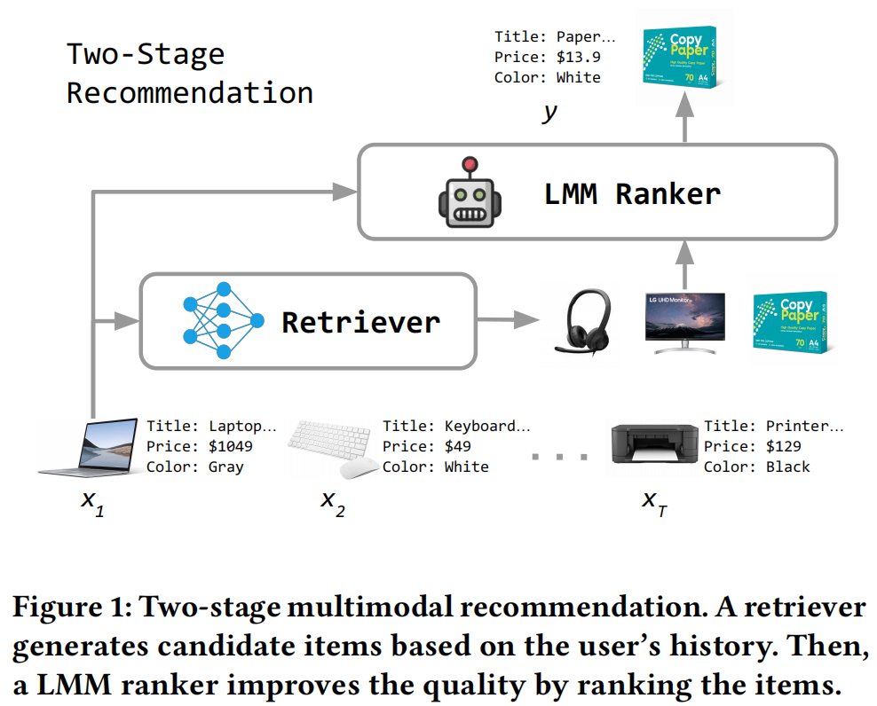
ATAI
AdvancedTechniqueof
Artificial Intelligence
ATAI
ChongqingUniversity _{AdvancedTechniqueof}
of Technology Artificial Intelligence
ChongqingUniversity of Technology
Experiments

Slide 7
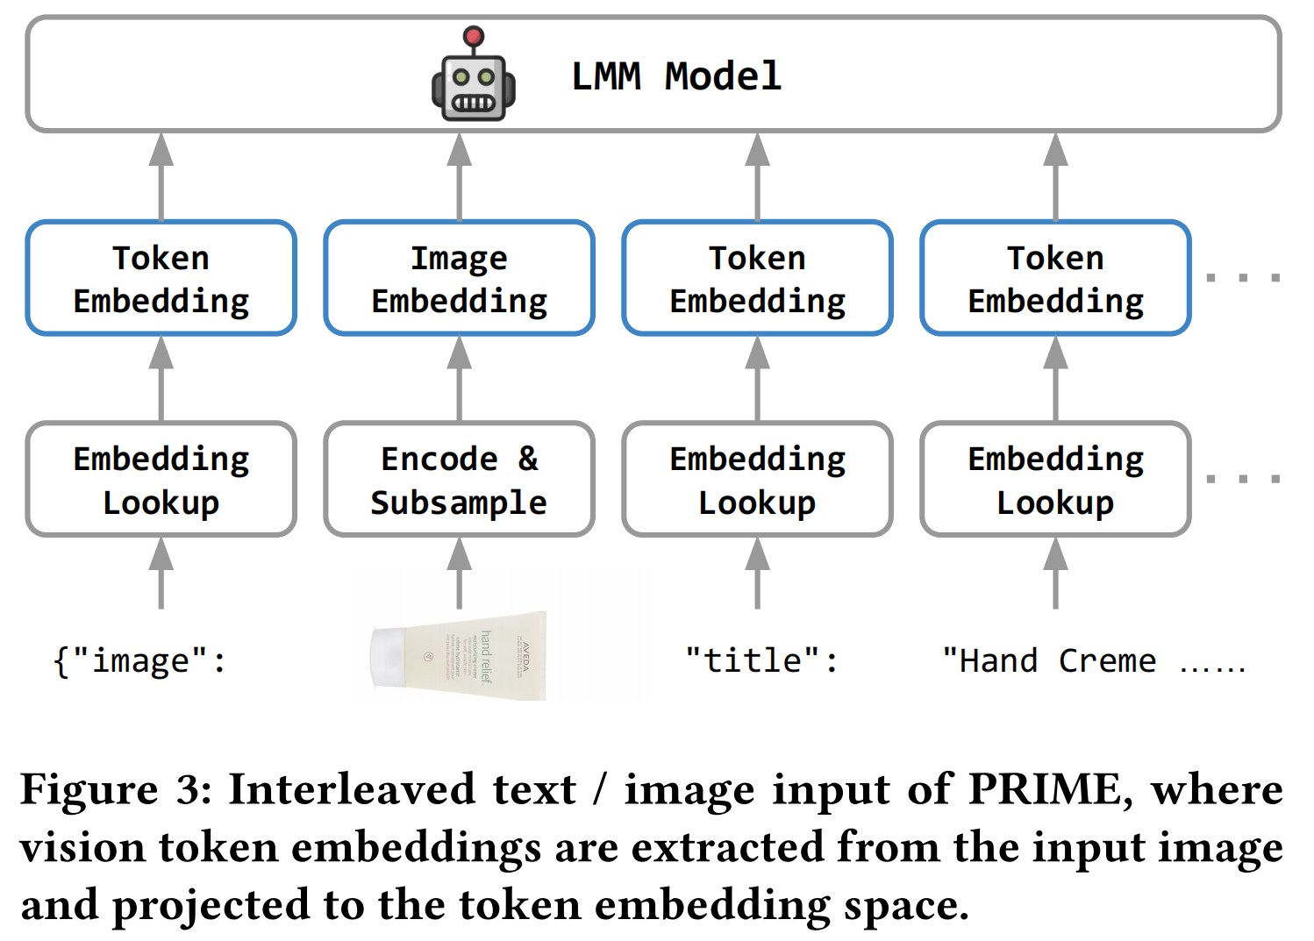
ATAI
AdvancedTechniqueof
Artificial Intelligence
ATAI
ChongqingUniversity _{AdvancedTechniqueof}
of Technology Artificial Intelligence
ChongqingUniversity of Technology
Experiments

Slide 8
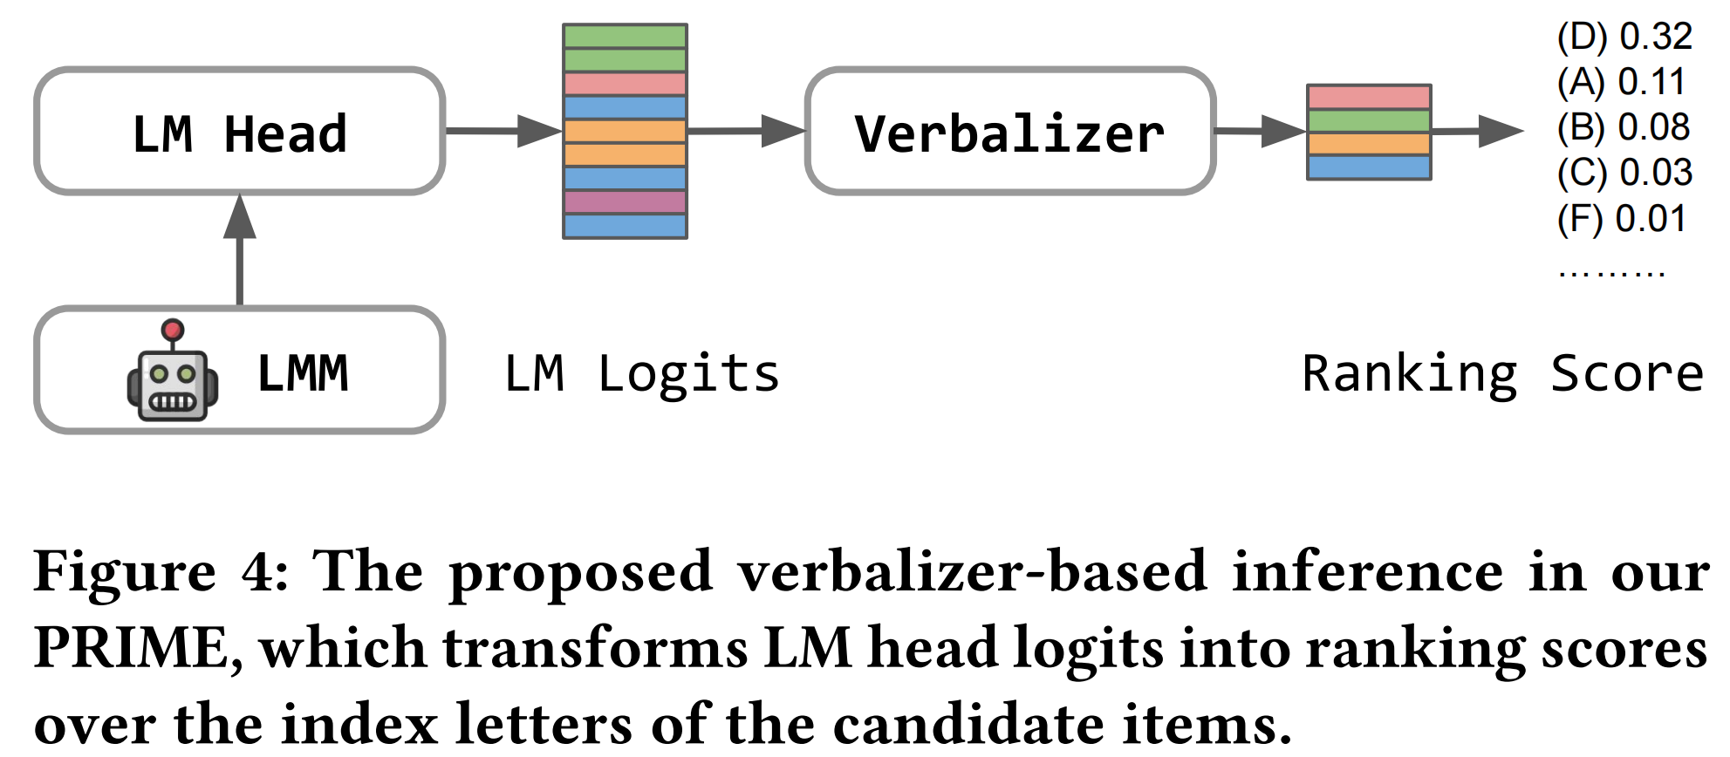
ATAI
AdvancedTechniqueof
Artificial Intelligence
ATAI
ChongqingUniversity _{AdvancedTechniqueof}
of Technology Artificial Intelligence
ChongqingUniversity of Technology
Experiments

Slide 9
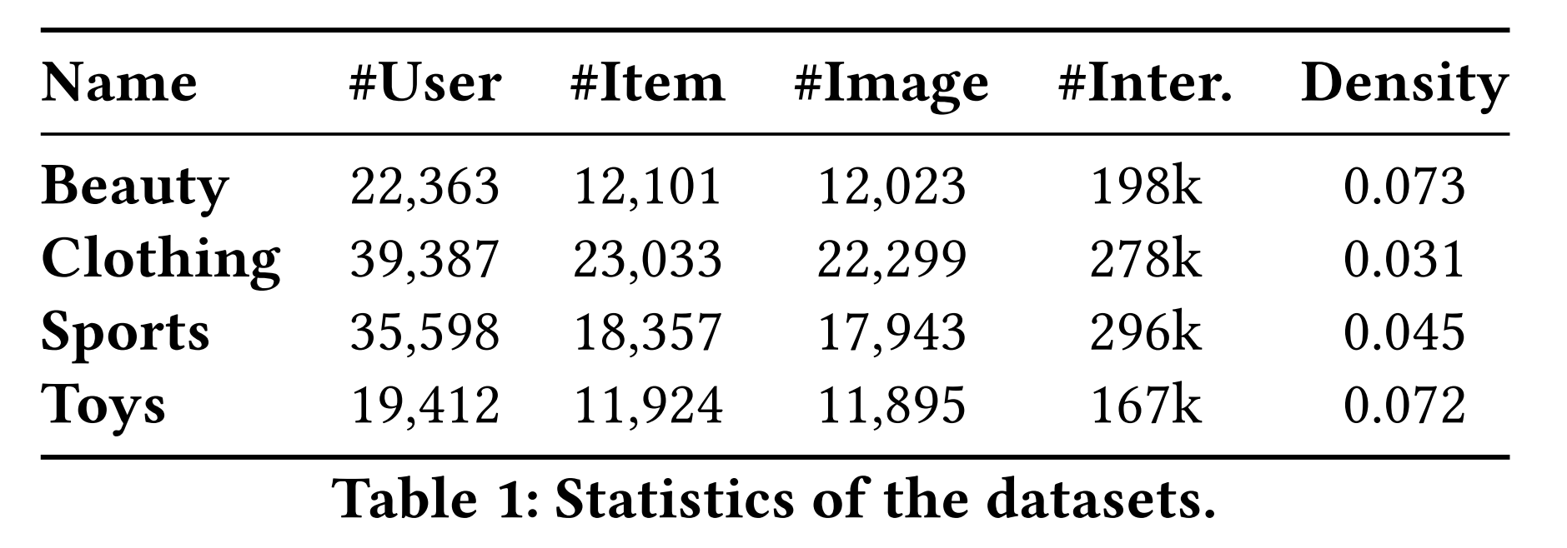
ATAI
AdvancedTechniqueof
Artificial Intelligence
ATAI
ChongqingUniversity _{AdvancedTechniqueof}
of Technology Artificial Intelligence
ChongqingUniversity of Technology
Experiments

Slide 10
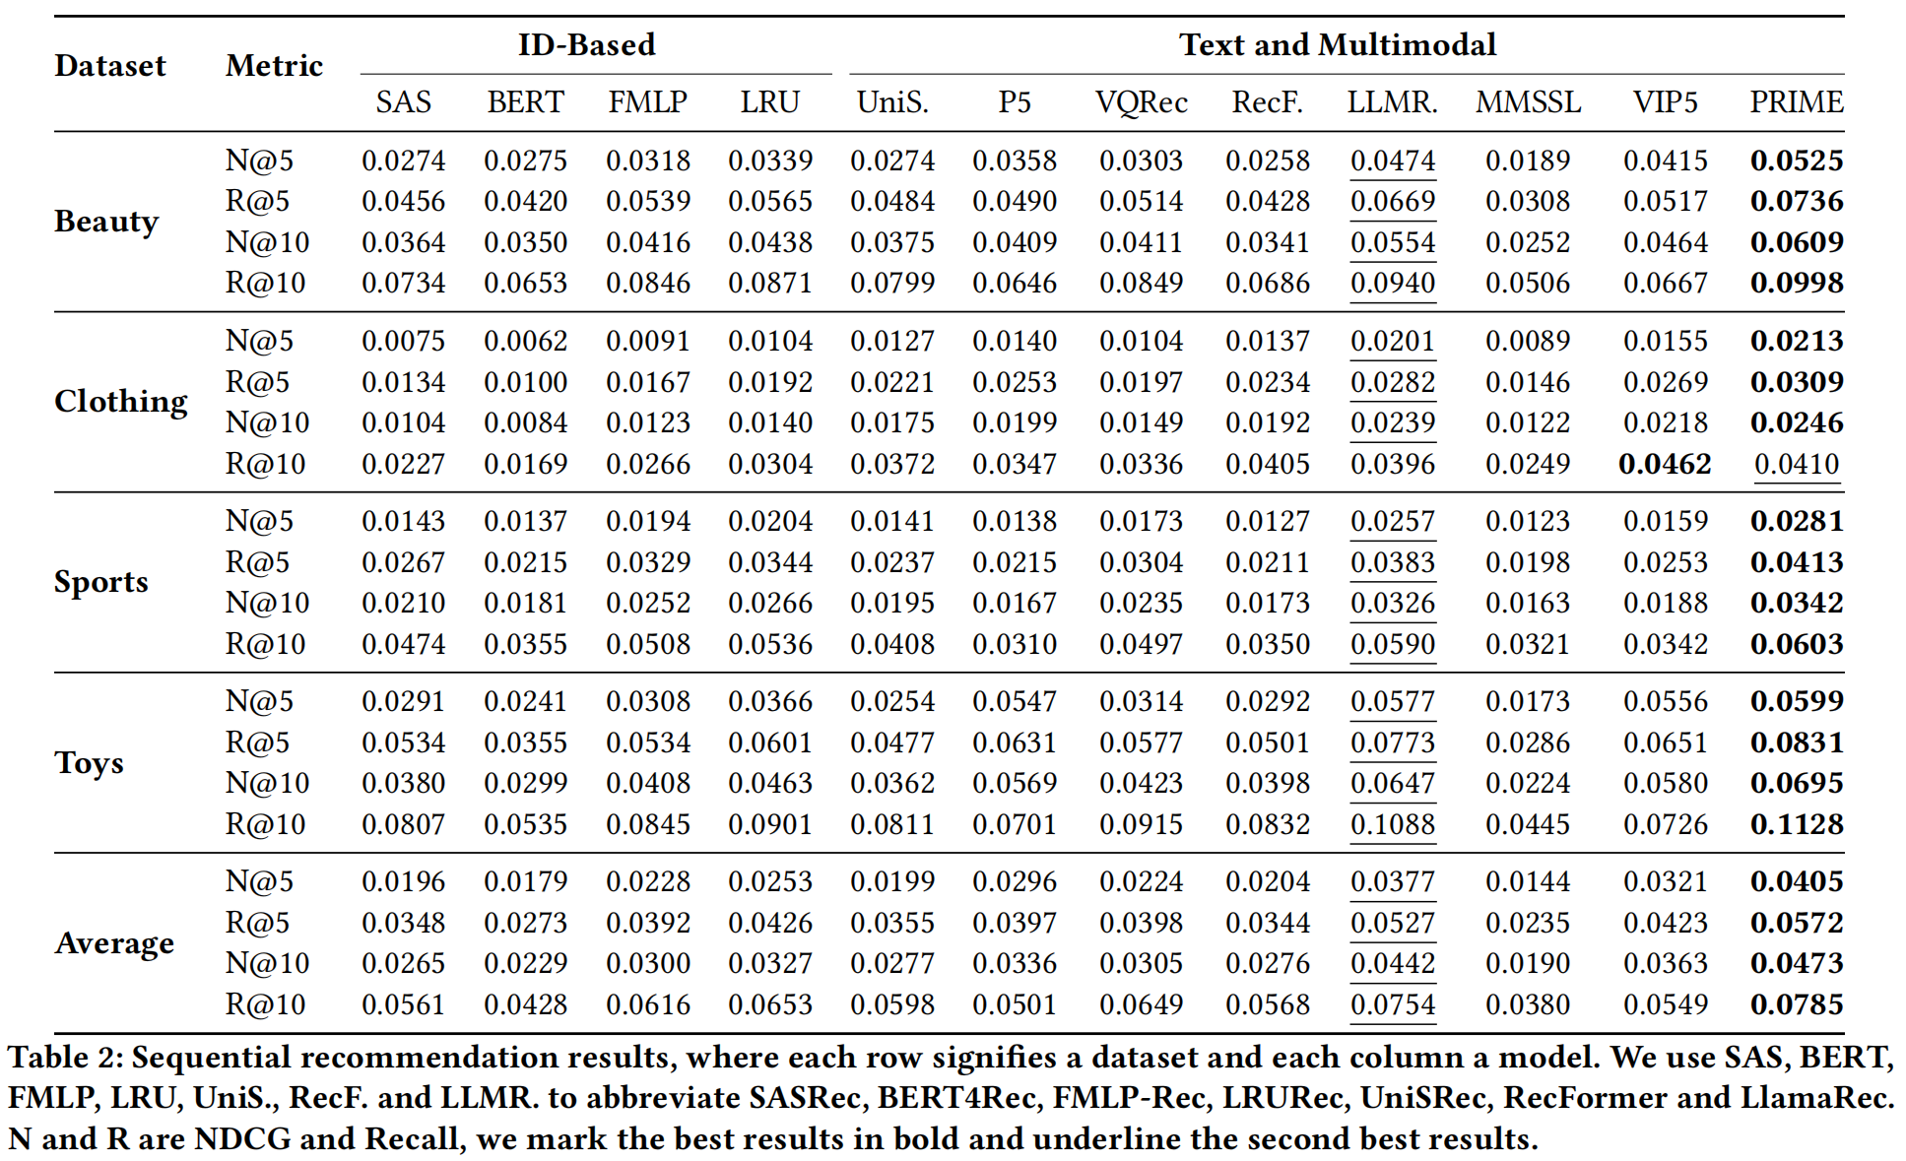
ATAI
AdvancedTechniqueof
Artificial Intelligence
ATAI
ChongqingUniversity _{AdvancedTechniqueof}
of Technology Artificial Intelligence
ChongqingUniversity of Technology
Experiments
0.0466
0.0680
0.0556
0.0961

Slide 11
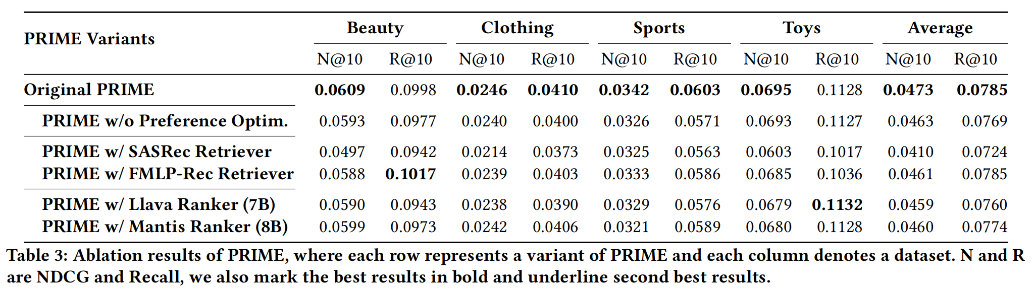
ATAI
AdvancedTechniqueof
Artificial Intelligence
ATAI
ChongqingUniversity _{AdvancedTechniqueof}
of Technology Artificial Intelligence
ChongqingUniversity of Technology
Experiments

Slide 12
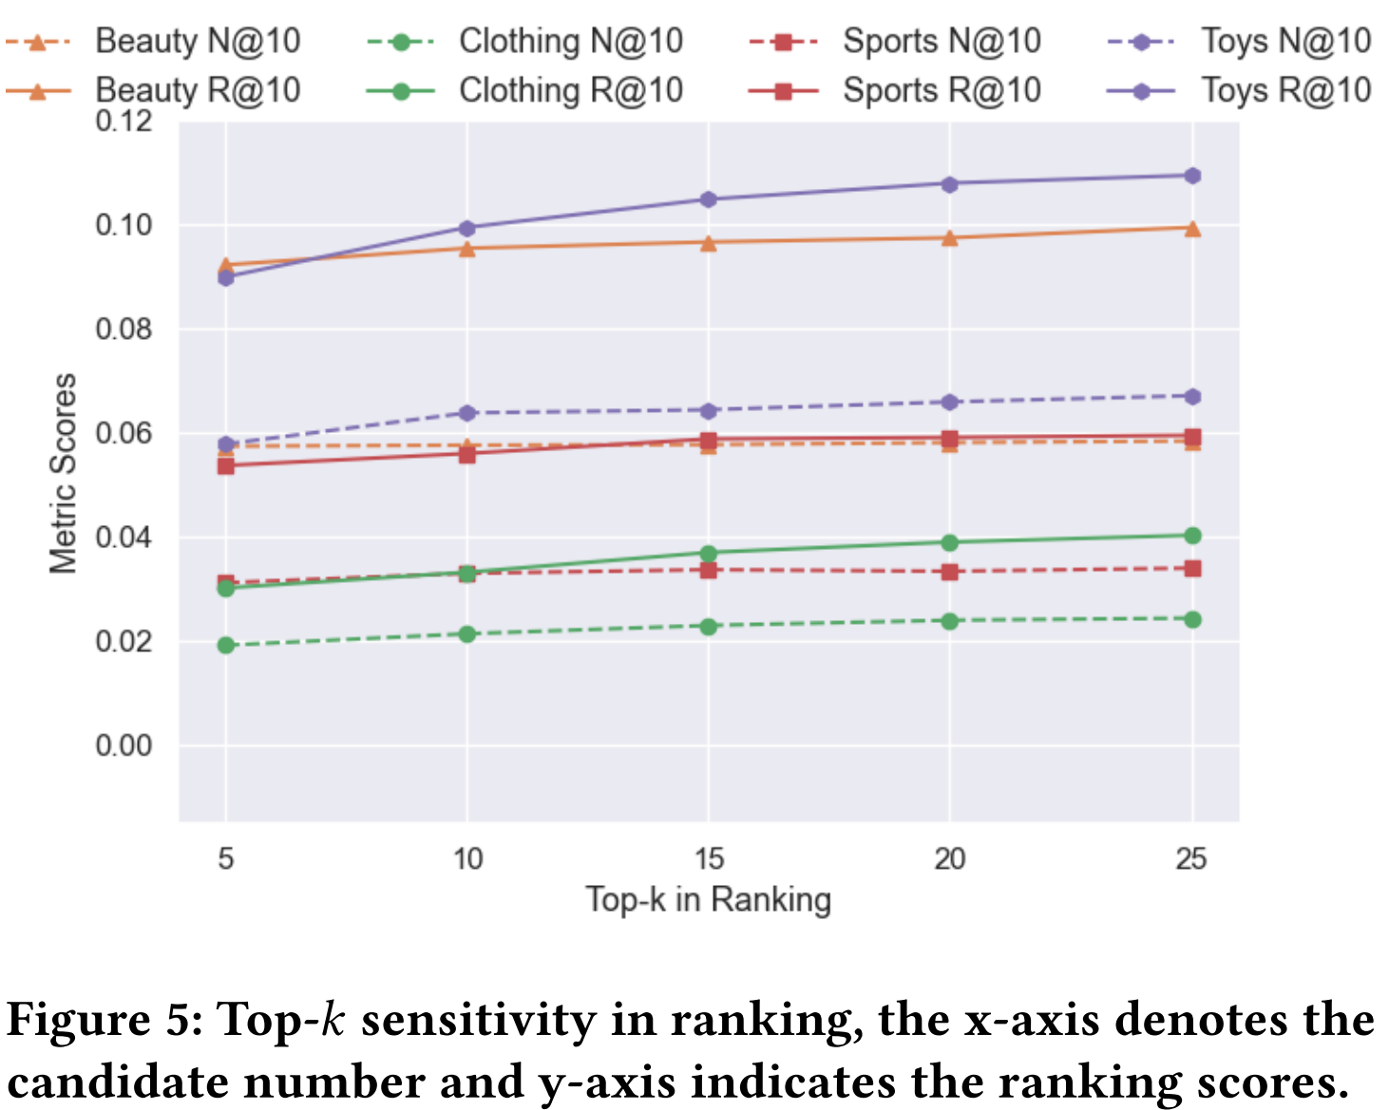
ATAI
AdvancedTechniqueof
Artificial Intelligence
ATAI
ChongqingUniversity _{AdvancedTechniqueof}
of Technology Artificial Intelligence
ChongqingUniversity of Technology
Experiments

Slide 13
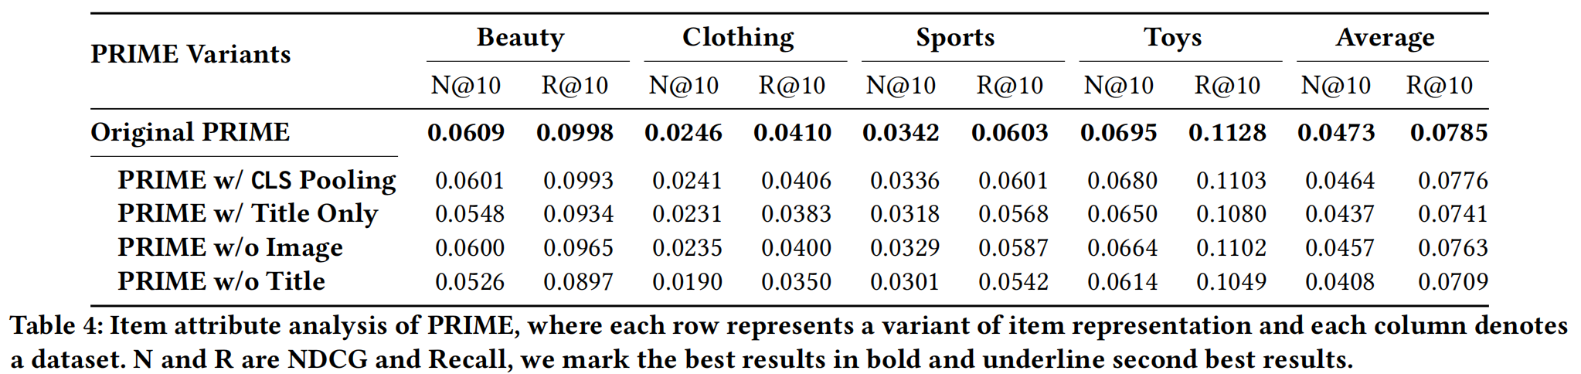
ATAI
AdvancedTechniqueof
Artificial Intelligence
ATAI
ChongqingUniversity _{AdvancedTechniqueof}
of Technology Artificial Intelligence
ChongqingUniversity of Technology
Experiments

Slide 14
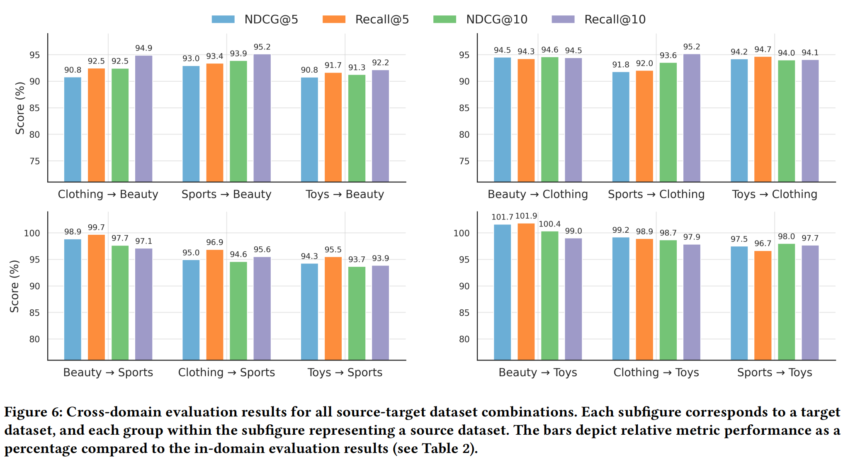
ATAI
AdvancedTechniqueof
Artificial Intelligence
ATAI
ChongqingUniversity _{AdvancedTechniqueof}
of Technology Artificial Intelligence
ChongqingUniversity of Technology
Experiments

Slide 15
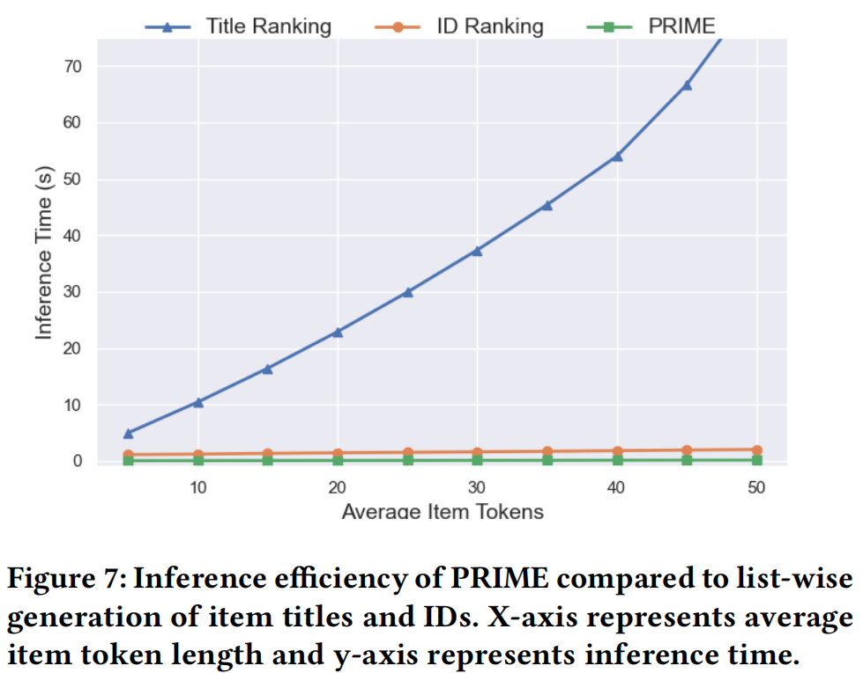
ATAI
AdvancedTechniqueof
Artificial Intelligence
ATAI
ChongqingUniversity _{AdvancedTechniqueof}
of Technology Artificial Intelligence
ChongqingUniversity of Technology
Experiments

Slide 16


ChongqingUniversity of Technology
ATAI
AdvancedTechniqueof
Artificial Intelligence
ATAI
ChongqingUniversity _{AdvancedTechniqueof}
of Technology Artificial Intelligence
Thanks!

